Slide 1
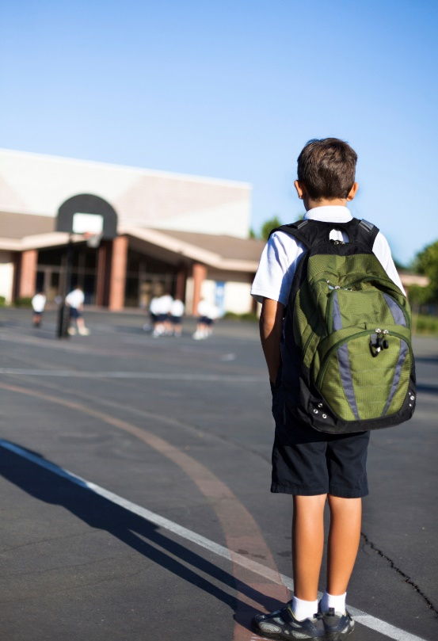
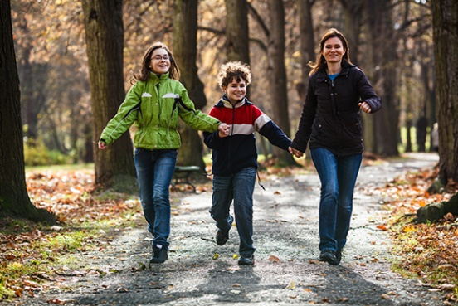

Trauma Recovery Informed Practice
How Mending Hurts can support recovery from trauma through day-to-day interactions

Slide 2
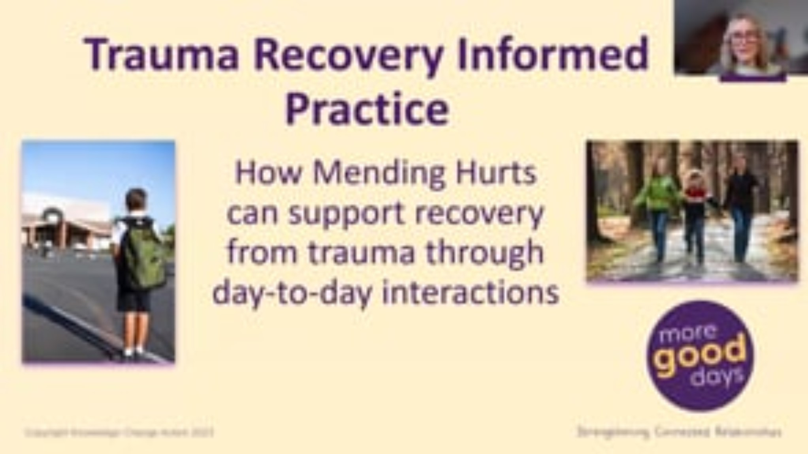

Slide 3

Reflective Question
How do you promote stabilisation, integration and adaptation through the relationships you form with people when they are vulnerable?

