Slide 1


Five to Thrive and the Importance of Relational Practice for Learning

Slide 2
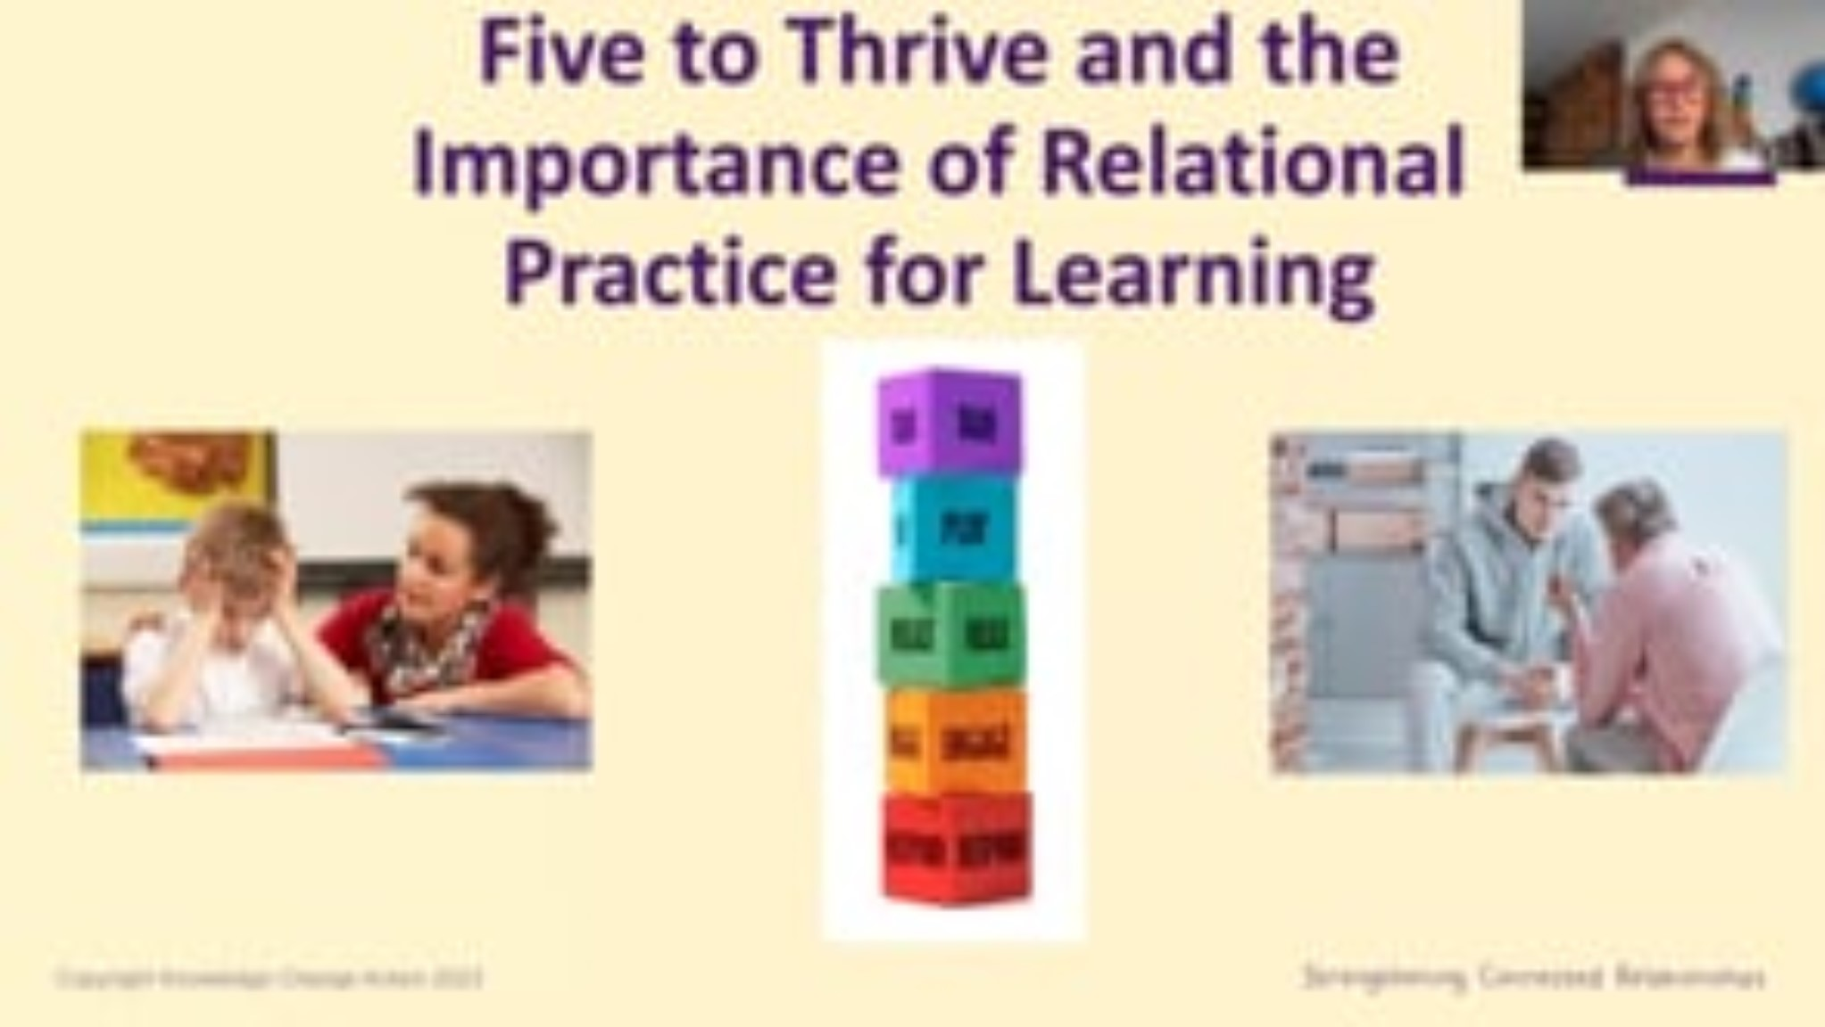

Slide 3
Reflective Question
What do you do on your best days to promote connected relationships with children and young people, colleagues and families and care-givers?

