Slide 1
LGBTQ+ Session
A group session to discuss and ask questions about the LGBTQ+ community
Delivered by
Steph Carter – Youth Worker

Slide 2
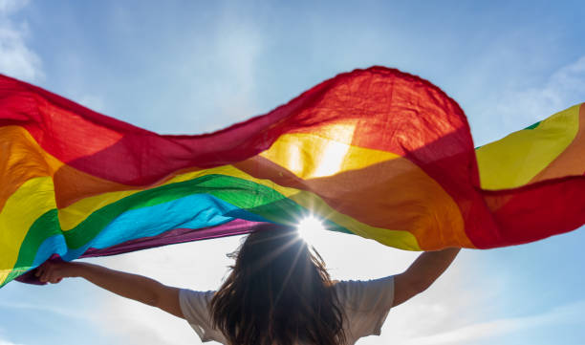
What do you know?
Please share what you already know about LGBTQ+ and the community.
Then can you say on a scale from 0 to 10, with 10 being you know everything about the LGBTQ+ Community and 0 being you know very little. Where would you scale today?

Slide 3
Understanding LGBTQ+

Slide 4
Other LGBTQ+ Terms
Demisexual
This is a term that describes people who may only feel sexually or romantically attracted to people they have formed an emotional bond with.
Pansexual
Refers to a person whose romantic and/or sexual attraction towards others is not limited by sex or gender.
Ally
A (typically) straight and/or cis person who supports members of the LGBT community.
Deadnaming
Calling someone by their birth name after they have changed their name.
Gender dysphoria
Used to describe when a person experiences discomfort or distress because there is a mismatch between their sex assigned at birth and their gender identity.
Gender Fluid
Gender fluid means a person who has an adaptable concept of gender identity and gender expression. They can be one gender, multiple genders, or no gender.
Notes:
https://www.youtube.com/watch?v=rorNb_CJn4k

Slide 5
Myths or Facts
1 Myth
2 Fact
3 Myth
4 Fact
5 Myth
6 Myth
7 Fact
8 Fact
9 Myth
10 Fact
Myth
#1 - Children shouldn't be raised by two moms or two dads.
#2 - Some transexuals feel GP’s don’t have a good understanding of their needs.
#3 - Pronouns aren't real.
#4 - Some people in the community hide the fact that they are LGBTQ+ whilst at work.
#5 - Trans people assault others in the bathroom.
#6 - Bisexuality is just a phase.
#7 - Those in the LGBTQ+ community are likely to be bullied at school
#8 - There are a lot of issues with homophobia and transphobia within sport.
#9 - "There are only two genders: man and woman.“
#10 - Most people in the community have been discriminated against, whether at work, school, through healthcare, public
Fact
Myth
Fact
Myth
Myth
Fact
Fact
Myth
Fact

Slide 6
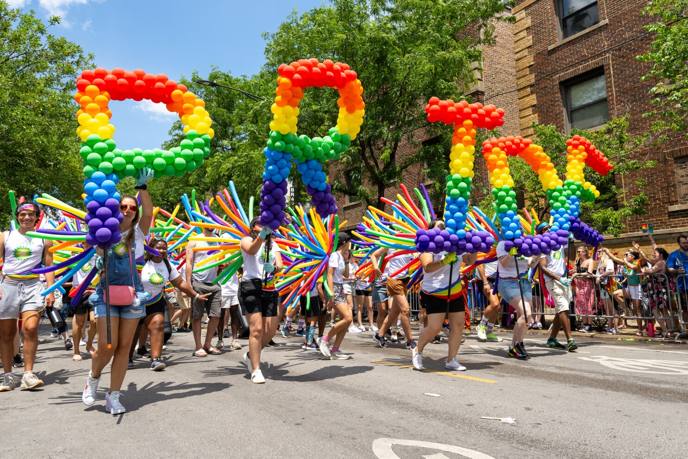
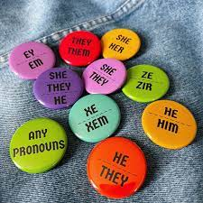
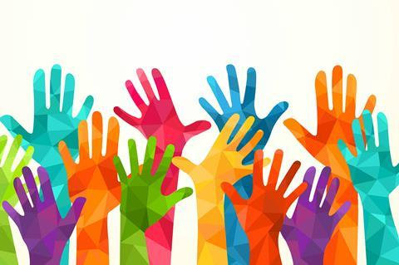
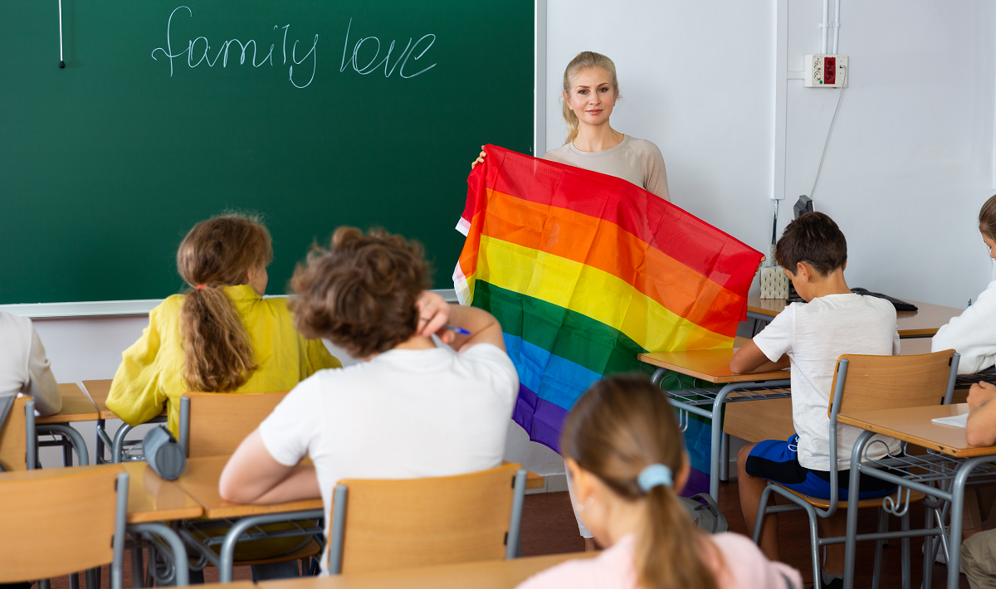
How to show your pride…
Be an ally
Share your flag
Attend a parade
Educate yourself
Wear pronoun badges
Advocate for others

Slide 7
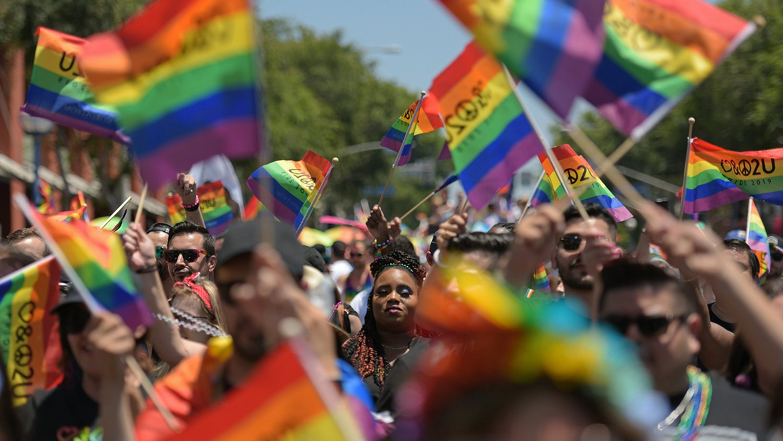
Q & A
Thank you for listening.
If you have any questions please feel free to ask them, I will do my best to answer them ☺

